Slide 1
Revai – AI DRIVEN REVENUE ANALYSIS FOR HOTELS
Milestone - 4
Team – D
Arun Kumar V
Satbir Singh
Chelikani Harshal
N. Akhila
Srilakshmi

Slide 2
Abstract
Revai is an AI-driven revenue analysis system designed for the hospitality industry. This project leverages a 4-year hotel booking dataset (2014–2017) to uncover actionable business insights through data preprocessing, advanced DAX metrics, and interactive Power BI dashboards. The system analyzes key performance indicators including revenue, cancellation rates, booking behavior, and customer segmentation across City and Resort hotel types. By transforming raw transactional data into structured intelligence, Revai empowers hotel management to make data-driven decisions that optimize revenue, reduce cancellations, and improve operational efficiency.

Slide 3
INTRODUCTION
The hotel industry operates in a highly dynamic environment where revenue management and customer behavior play a critical role in profitability.
Traditional approaches to booking analysis often fall short in providing real-time, granular insights.
Revai addresses this gap by building an end-to-end analytical pipeline — from raw data ingestion and cleaning to KPI modeling and dashboard visualization.
Using Power BI and DAX, this project translates complex booking-level data into five interactive dashboards covering revenue trends, booking behavior, customer segmentation, predictive cancellation risk, and cancellation patterns — enabling strategic, informed decision-making for hotel management teams.

Slide 4
PROBLEM STATEMENT
Hotels generate vast amounts of booking data but often lack the tools to convert this data into meaningful revenue insights. Key challenges include:
High cancellation rates leading to revenue leakage and poor demand forecasting
Lack of visibility into which market segments and customer types drive the most revenue
Inability to identify pricing inefficiencies due to fragmented ADR (Average Daily Rate) analysis
No predictive framework to proactively assess cancellation risk before it impacts occupancy
Limited understanding of customer behavior patterns across geographies and booking channels
Revai solves these challenges by delivering a structured, KPI-driven analytics platform that provides hotel stakeholders with clear, actionable insights from historical booking data.

Slide 5
Project work flow
💼 Work Flow of the Project
Raw Booking Data ⬇ Cleaned & Modelled Data ⬇ KPI-Based Analysis ⬇ Interactive Dashboards ⬇ Actionable Business Insights

Slide 6
ABOUT THE DATASET
The dataset used is a 4-year Hotel Booking Dataset, containing booking-level information from 2014-2017 such as:
Hotel type (City / Resort)
Market segment
Distribution channel
Guest details (Adults, Children, Babies)
Stay details (Weekday & Weekend nights)
ADR (Average Daily Rate)
Cancellation flag
Arrival date information
Country, customer type, and other booking attributes
The dataset consists of booking-level transactional records, which makes it ideal for KPI-driven analysis.

Slide 7
DATA PREPROCESSING
Before analysis, data cleaning and transformation were performed in Power Query Editor.
Removed unnecessary columns
Handled missing values
Removed duplicate records
Corrected data types
Date fields → Date format
Numeric fields → Whole / Decimal numbers
Categorical fields → Text
5. Standardized categorical values
Ensured consistency across fields like:
Market Segment
Distribution Channel
Customer Type

Slide 8
DATA MODELING
To enrich the dataset, new calculated columns were created:
🔹 Total Stay
Total Stay = Weekend Nights + Weekday Nights
🔹 Total Guests
Total Guests = Adults + Children + Babies
🔹 Revenue
Revenue = ADR × Total Stay

Slide 9
DAX METRICS
After data modeling, DAX was used to create reusable business KPIs.
🔹 1. Average ADR
Average ADR = AVERAGE(hotel_booking_main[adr])
Used to understand pricing trends.
🔹 2. Total Bookings
Total Bookings = COUNTROWS(hotel_booking_main)
Core business metric.
🔹 3. Total Cancellations
Total Cancellations = CALCULATE( COUNTROWS(hotel_booking_main), hotel_booking_main[is_canceled] = 1 )
🔹 4. Total Confirmed
Total Confirmed = CALCULATE( COUNTROWS(hotel_booking_main), hotel_booking_main[is_canceled] = 0 )
🔹 5. Cancellation Rate %
Cancellation Rate % = DIVIDE( [Total Cancellations], [Total Bookings], 0 )

Slide 10
DAX METRICS
After data modeling, DAX was used to create reusable business KPIs.
🔹 6. Total Guests
Total Guests = SUM(adults) + SUM(children) + SUM(babies)
🔹 7. Total Revenue
Total Revenue = SUMX( hotel_booking_main, hotel_booking_main[adr] * (stays_in_week_nights + stays_in_weekend_nights) )
🔹 8. Total Nights
Total Nights = SUM(stays_in_week_nights) + SUM(stays_in_weekend_nights)
🔹 9. Revenue TY (Time Intelligence)
Revenue TY = CALCULATE( [Total Revenue], DateTable[Year] = YEAR(TODAY()) )

Slide 11
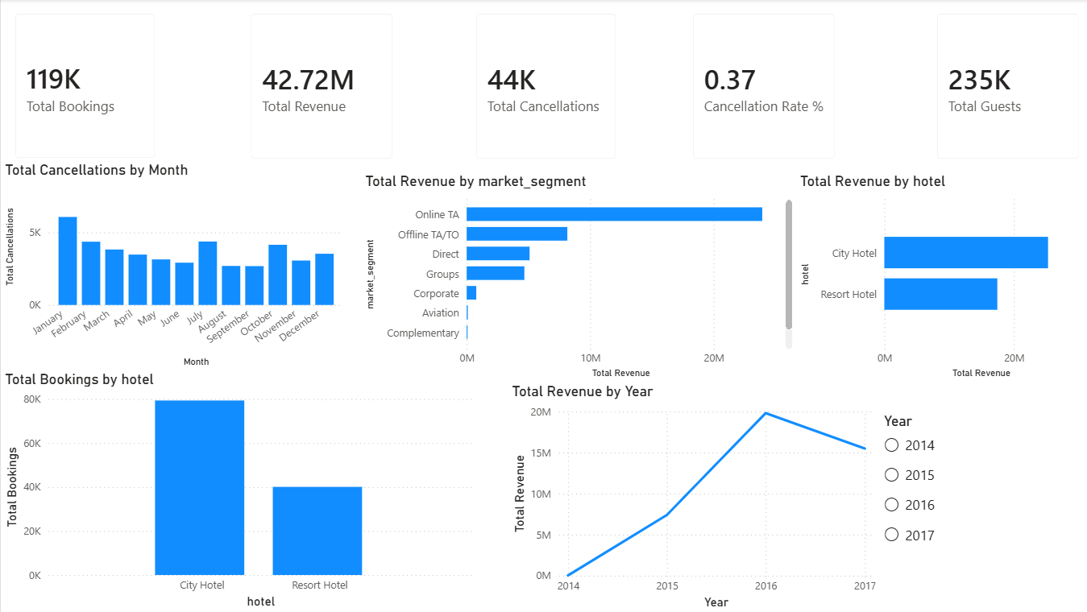
DASHBOARD 1 : REVENUE DASHBOARD
Key KPIs Displayed:
Total Bookings
Total Revenue
Total Cancellations
Cancellation Rate
Total Guests
Insights Enabled:
Revenue by market segment
Year-wise revenue trend
Monthly cancellation pattern
Booking distribution across hotels
Revenue comparison between City & Resort hotels
This dashboard helps management understand where revenue is coming from and which segments are most profitable.

Slide 12
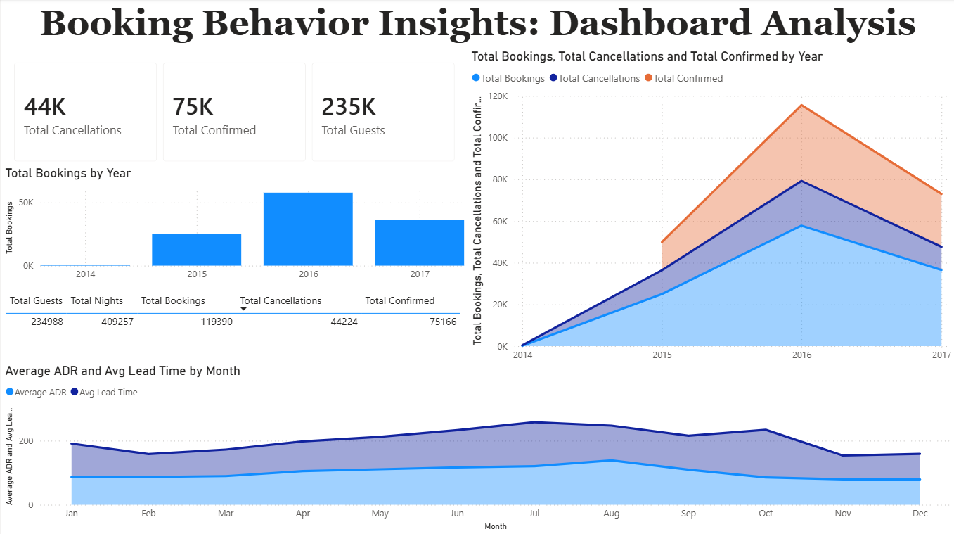
DASHBOARD 2 : BOOKING BEHAVIOUR ANALYSIS
Key Visuals:
Total bookings, confirmations, cancellations
Year-wise distribution
Average ADR vs Average Lead Time
(monthly trend)
Business Value:
Identifies peak booking months
Shows how lead time affects pricing
Enables forecasting and demand planning
This dashboard supports operational planning and pricing strategies.

Slide 13
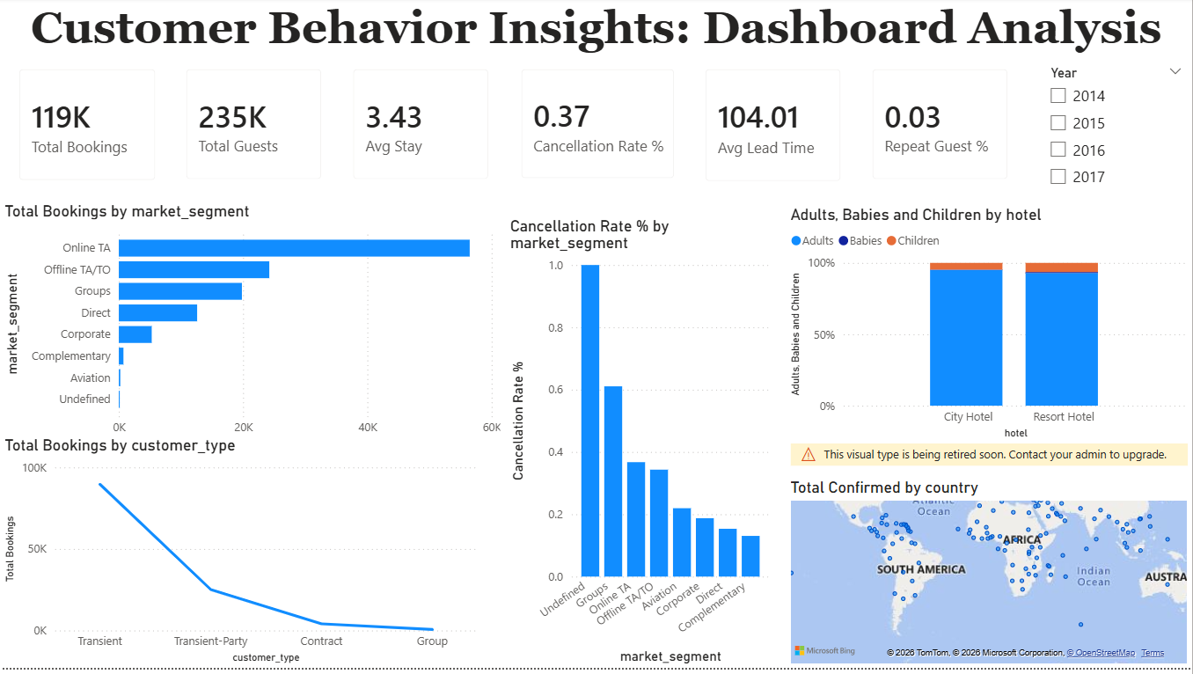
DASHBOARD 3 : CUSTOMER BEHAVIOUR ANALYSIS
Key Insights:
Bookings by market segment
Cancellation rate by segment
Adults, babies, children distribution
Customer type analysis
Country-wise booking distribution
Business Impact:
Helps identify high-risk cancellation segments
Reveals most profitable customer groups
Enables targeted marketing strategies
This dashboard supports customer segmentation and personalization strategies.

Slide 14
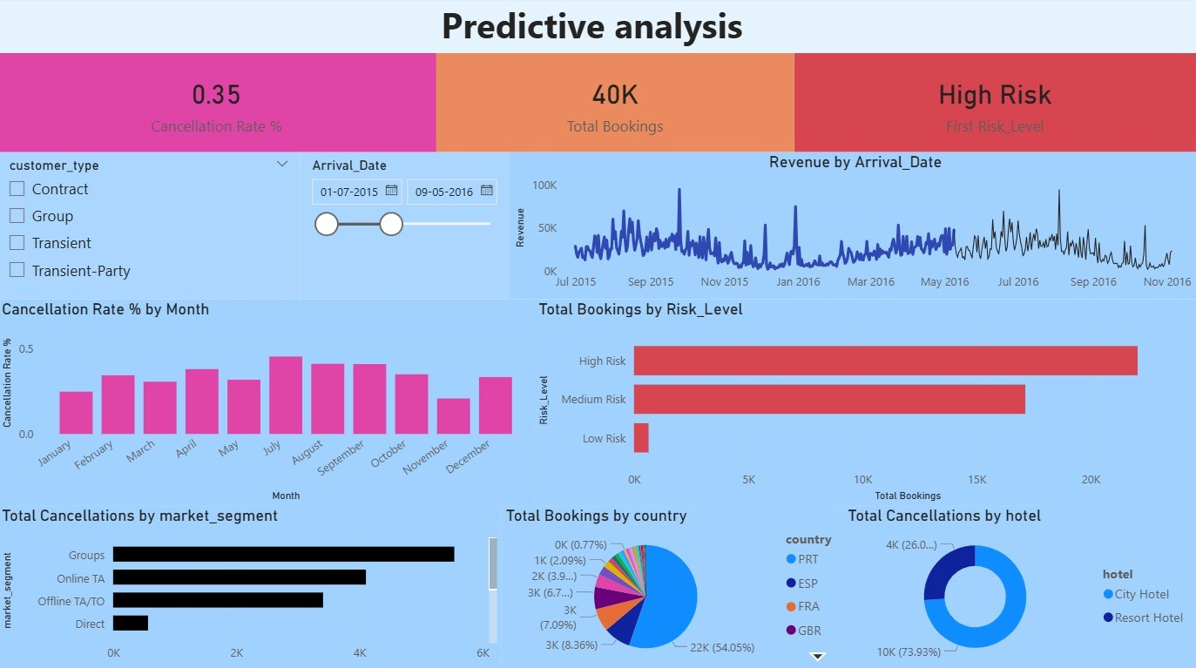
Dashboard 4 : PREDICTIVE ANALYSIS
📌 Key KPIs
Cancellation Rate
Total Bookings
Risk Level
📊 Key Insights
Revenue by Arrival Date
Cancellation Rate by Month
Bookings by Risk Level
Cancellations by Hotel
Bookings by Country
Cancellations by Market Segment
Business Value
This is a Predictive Analysis Dashboard focused on cancellation risk evaluation.

Slide 15
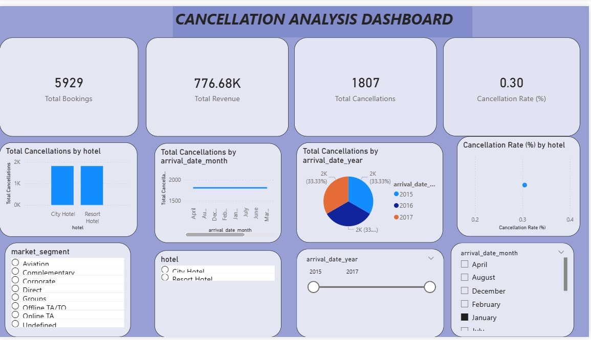
DASHBOARD 5 : CANCELLATION ANALYSIS
Key KPIs Displayed:
Total Bookings Represents total bookings within the selected filters.
Total Revenue Revenue generated in the selected period.
Total Cancellations Total bookings that were cancelled.
Cancellation Rate (%) Indicates the percentage of bookings that were cancelled.
This dashboard supports customer cancellation patterns and analysis

Slide 16
BUSINESS IMPACT
1️⃣ Revenue Optimization
Identified top-performing market segments.
Compared revenue performance between City and Resort hotels.
Analyzed ADR trends across months and years.
Evaluated revenue contribution by customer types.
2️⃣ Improved Occupancy & Demand Planning
Analyzed booking distribution across years and months.
Studied lead time patterns and stay duration.
Evaluated guest volume trends (Adults, Children, Babies).
3️⃣ Risk Monitoring & Revenue Protection
Measured cancellation rate and total cancellations.
Identified seasonal and hotel-level cancellation risks.
4️⃣ Customer Segmentation & Targeting
Segmented customers by market segment and customer type.
Identified repeat guest percentage.
5️⃣ Data-Driven Decision Framework
Created reusable DAX-based KPIs.
Built interactive dashboards with dynamic filters.

Slide 17
CONCLUSION
The Revai project successfully demonstrates how AI-driven data analytics can transform hotel revenue management.
By processing and modeling a comprehensive 4-year booking dataset, the project delivered five interactive dashboards that provide deep visibility into revenue performance, booking trends, customer behavior, and cancellation risk.
The DAX-powered KPIs and Power BI visualizations equip hotel management with the tools needed to optimize pricing strategies, reduce cancellation losses, and target high-value customer segments.
This project establishes a scalable, reusable analytical framework that can be extended with real-time data feeds and machine learning models for even more accurate forecasting and revenue optimization in the future.

Slide 18


